Slide 1
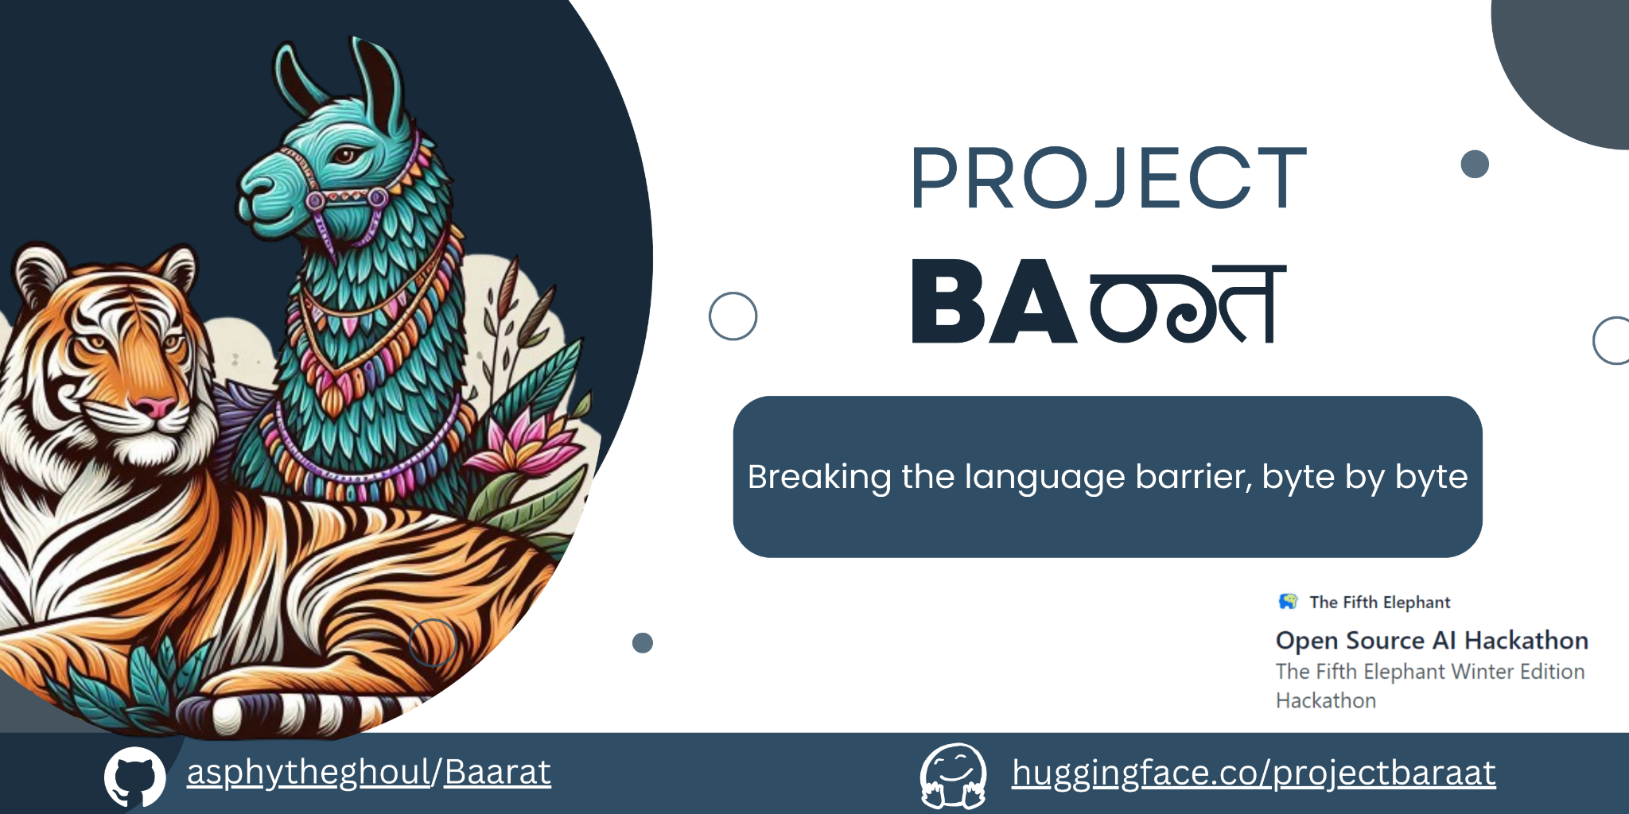
Project Baraat
Team members: Akash Kamalesh, Anirudh Lakhotia, Tanistha Hota
Github repo: https://github.com/asphytheghoul/Baarat
https://hasgeek.com/fifthelephant/open-source-ai-hackathon/

Slide 3

What is unique about the project
Our initiative aims to enhance natural language processing for Indian languages using a multifaceted approach. We've designed robust tokenization tools tailored to the intricate structures of regional Indian languages, ensuring precise and efficient processing.
By harnessing Large Language Models (LLMs) in a novel architecture, trained and fine-tuned for Indian languages, we facilitate comprehensive text understanding and generation.
We embrace open-source collaboration, engaging the community to drive innovation and inclusivity, recognizing the collective potential to propel progress.
We offer a hub of ready to use models, tokenizers and datasets that are regularly updated and improved.
It empowers researchers and developers to use these resources with confidence. Through these endeavors, we seek to democratize access to cutting-edge NLP technologies, enriching the linguistic landscape and empowering users across India.

Slide 4
Roadmap of the project
Preparation and setup of datasets
Preparation and setup of tokenizers
Pre-training phase
Fine-tuning models
Implementation of MoE
Implementation of Language Routing
Creation of a python package with utility functions for ease of access on a single GPU
Demo

Slide 5
Roadmap of the project
1
2
3
4
Preparation and setup of datasets
Preparation and setup of tokenizers
Pre-training phase
Fine-tuning models
Curate datasets via an extension of existing datasets with synthetically generated data about fruits, vegetables, and colours Create pipelines to automate the cleaning process, and batch sentences to create longer sequences for pre-training
Developed two BPE SentencePiece Tokenizers with an extended vocabulary of approximately 48,000 tokens each for Hindi and Kannada languages,
This approach prioritizes efficiency during tokenization, particularly crucial for faster processing during inference.
Begin pre-training using the LLaMa-2 base model with Unsloth AI using LoRA for the particular language using the tokenizer and pre-training dataset. Merge the trained model to a 16-bit vLLM.
We utilize pre-trained models as foundational models and then refine multiple instances tailored to specific tasks through fine-tuning.

Slide 6
Roadmap of the project
5
6
7
8
Implementation of Mixture of Experts
Implementation of Language Routing
Creation of a Python package
Demo of the project
Generate language-specific specialists by employing Mergekit on the refined experts.
We implement language routing using a fasttext model trained to identify the source language and which expert to send the input to.
Publish a Python package to PyPi to facilitate the use of utilities. Support all functions on a single GPU
Create a video showcasing our journey, and models Highlighting a few use-cases of the project

Slide 7
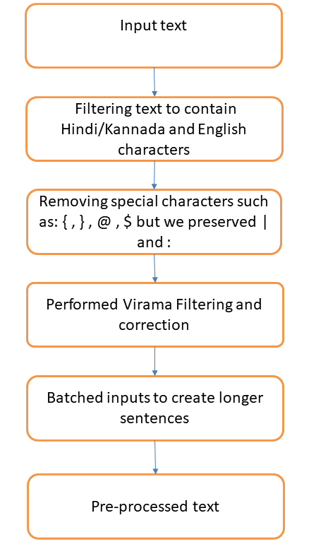
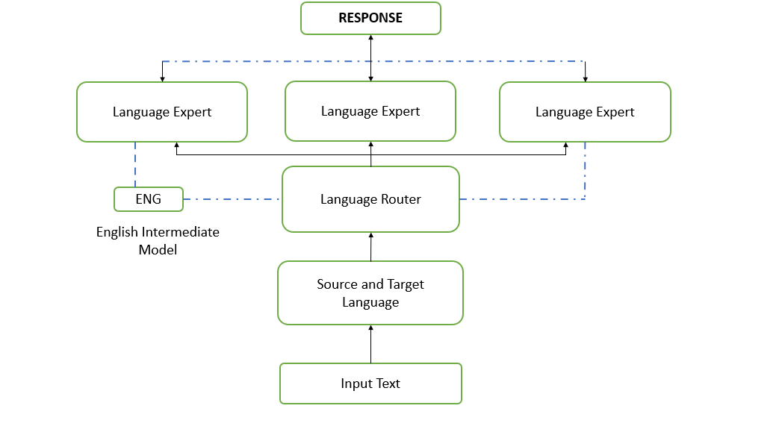
Architecture / Flow diagram for the project
Pre-processed text

Slide 8
Training and fine-tuning of models
What was Tried?
We employed the base Transformer’s Trainer class alongside SFTTrainer for model training. The SFTTrainer yielded individual experts with superior performance.
We initially attempted Full Fine Tuning of models during the pre-training phase; however, due to its extensive computational demands and protracted duration (spanning weeks), we opted for the more parameter-efficient LoRA approach.
Our efforts to adopt the Switch Transformers method for creating a mixture of experts were met with several impasses, primarily due to the varying tokenization methods used across different languages. This discrepancy posed a significant obstacle to the routing process, as it required a unified tokenizer capable of effectively handling multiple languages at scale, which proved to be unfeasible.

Slide 9
Training and fine-tuning of models
What was Tried?
We chose to develop language-specific Mixtures of Experts (MoEs) (as opposed to the final architecture choice of task-specific Mixture of Experts), a strategy that aligned with our objectives. To circumvent the complexities associated with constructing MoEs at this juncture, we deferred the adoption of Switch Transformers to future projects. Instead, we concentrated on utilizing Mergekit—a highly robust and acclaimed framework for building Mixtral-style MoEs—capitalizing on fine-tuned models.
We merged our fine-tuned experts into a Mixture of Experts utilizing gradient-free merging methods from MergeKit. We pass a few positive and negative prompts for each expert and then train the router with these prompts.The “hidden” option uses the hidden state representations of the positive/negative prompts for MoE gate parameters. It is the best quality and most effective option.

Slide 10
Training and fine-tuning of models
What was Tried?
In our experiments, we also trained models without the use of unsloth. We noted that incorporating unsloth resulted in a training speed that was approximately 2.2 times faster for an equivalent number of steps.
We refrained from appling any form of quantization to the models throughout the process, both training and inference were conducted without applying quantization.

Slide 11
Training and fine-tuning of models
Base Model: For the pre-training phase, we utilized the LLaMa-2 7B model as the foundational architecture for both Hindi and Kannada languages.
We selected LLaMa-2 as our starting point for developing Indic NLP Large Language Models (LLMs) due to its reliability and established performance. Meta AI has further enhanced the safety of these models, enabling their deployment without the need for additional model alignment steps—subject to the toxicity levels of the datasets used for fine-tuning—by employing safeguards like LLaMa Guard.
Our ambitions extend beyond LLaMa-2. Acknowledging the advancements introduced by Mistral AI’s 7B parameter model, we plan to broaden our scope to include Mistral and other smaller, emerging language models shortly. Our goal is to create a diverse ecosystem of models, providing users with a variety of options beyond a single model.
We advocate for an encoder-decoder framework as a more robust approach to this challenge. This architecture surpasses mere next-word prediction by facilitating the comprehension of complex word relationships, which is particularly beneficial when dealing with the intricacies of entirely new languages.

Slide 12
Training and fine-tuning of models
Training Details
0) Setup the Tokenizer and Dataset
We initiated the development of two distinct tokenizers, each with an expanded vocabulary of approximately 48,000 tokens tailored for Hindi and Kannada respectively. An extensive vocabulary in a tokenizer is crucial as it reduces the overall number of tokens required and ensures accurate language tokenization, which significantly enhances the speed of tokenization, particularly during inference.
We have trained two BPE SentencePiece Tokenizers, maintaining the LLaMa-2 tokenizer architecture and extended their vocabularies to create a tokenizer for the Hindi and Kannada languages separately.
Our Tokenizers result in a consistent 7.5% reduction in the number of tokens required on very long sequences of data compared to the base LLaMa-2 tokenizer.
The datasets required for all tasks have been pre-processed. We have completed all the essential preparations for the training process and commenced the training of the model.

Slide 13
Training and fine-tuning of models
Pre-training step on the language:
Our training process commenced with a base model tailored to the specific language in focus. We meticulously prepared and sanitized multiple datasets, including one designated for pre-training, and proceeded to load the custom tokenizer developed in the preceding step.
Utilizing the Unsloth AI framework, we applied LoRA (Low Rank Adaptation matrices) to our foundational LLaMa-2 7b model. For the pre-training phase, we selected a rank of 256 and a fixed alpha value of 16. We then instantiated our Trainer using the SFTTrainer, setting a training batch size of 4 and gradient accumulation steps of 2, resulting in an effective batch size of 8.
This innovative application of LoRA represents a novel approach to pre-training in a distinct language context.
As part of a hackathon project, we crafted a Proof of Concept implementation, conducting the pre-training phase for approximately 0.27 of an epoch before transitioning the saved model to a 16-bit vLLM, which we have dubbed ‘baraat-<language>-pretrained’.

Slide 14
Training and fine-tuning of models
2) Fine-tuning individual experts
With the language base model now ready, we start the fine-tuning process for each task. In our project’s scope we have defined 4 main tasks:
Translation
Question and Answering
Mathematical Reasoning
Instruct Tuning
We discovered that the text summarization capability was inherently acquired during the instruct tuning phase, obviating the need for a separate model dedicated to this task. For fine-tuning individual experts, we followed a similar protocol to pre-training but adjusted the LoRA rank factor to 32, a reduction from the initial 256, as the more intricate relationships had already been established during pre-training. The fine-tuning phase serves to enhance the base model’s proficiency across various tasks.
We have implemented a small demo of the Mixture of Experts (MoE) using Gradio.

Slide 15
Training and fine-tuning of models
Training Details
3) Creating the Mixture of Experts Model
Upon preparing all fine-tuned experts, we turned our attention to constructing our Mixture of Experts. Initially, we contemplated a task-specific MoE architecture comprising of multiple languages but encountered significant complexities, particularly with tokenizer compatibility, which we anticipated would hinder scalability with the addition of more languages.
Consequently, we pivoted to a language-specific Mixture of Experts approach, selecting Mergekit as the foundational platform. Mergekit facilitates the creation of a Mixtral-style MoE by integrating various algorithms to amalgamate individual experts.
We leveraged Mergekit’s “hidden” feature to forge a language-specific MoE, amalgamating the fine-tuned experts for each language. This “hidden” feature employs the hidden state representations from positive/negative prompts to calibrate the MoE gate parameters, ensuring optimal quality and efficacy.

Slide 16
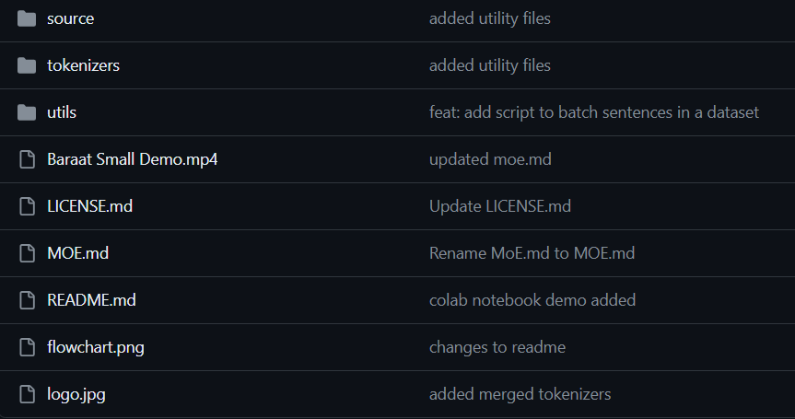
Code walk through
This file includes functions for routing languages and task-specific operations.
Loading and evaluating Llama2 7B tokenizers along with the tokenizers we specifically designed for Indic languages.
This file provides functionality for counting tokens, organizing sentences into batches, and managing token-related operations.
A demonstration video showcasing the functionality and operation of the model.
This document provides a comprehensive explanation of mixture of experts, detailing its components and workings.
This document outlines the sequential stages and processes involved in the project's workflow.
This file includes the logo of the project.

Slide 17
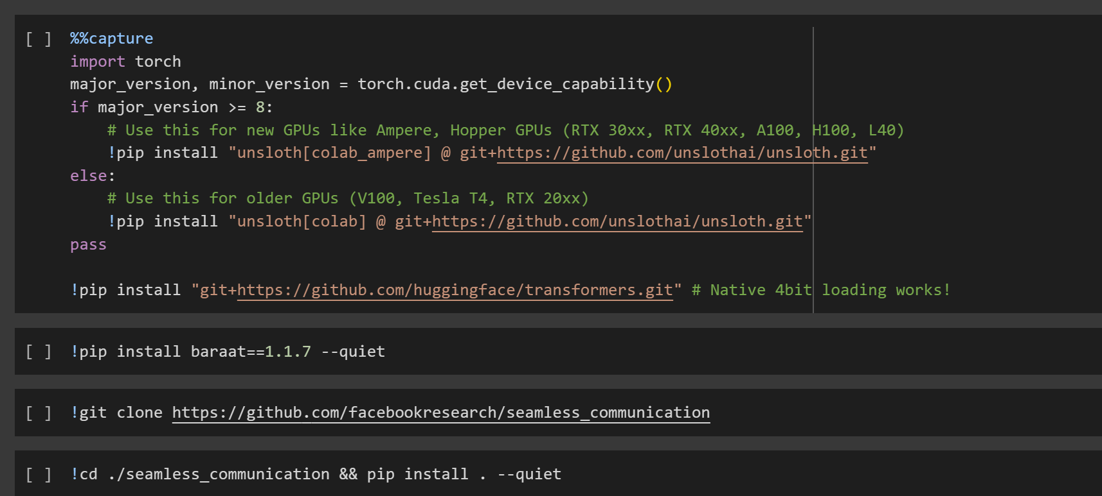
Code walk through
Notebook Link
We need to first install the ‘unsloth’ package. This package is important because we are using unsloth for loading the model and running inference on a Single T4 GPU.
We then proceed to install the ‘Baraat’ package hosted on PyPi. This package will be updated regularly with constant updates to its utility functions. This package serves as a wrapper for providing a simple and user-friendly way of running inference against our models.
Install and build seamlessm4t. We will very soon be extending support to voice-based inputs and this is where seamless would play a big role in doing speech-speech or speech-text tasks etc.

Slide 18
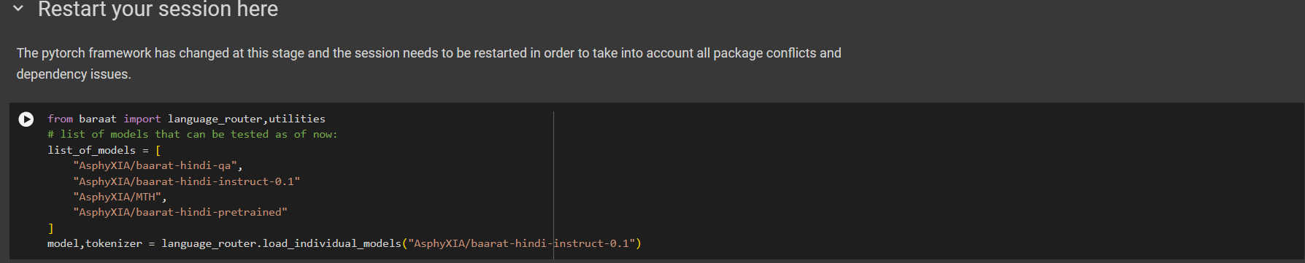
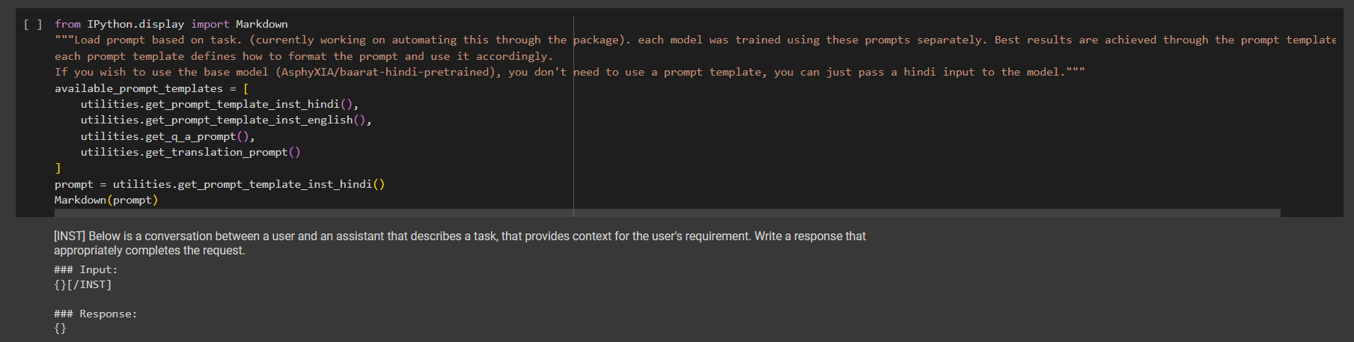
Code walk through
We import the baraat package and choose the model to run inference on with the appropriate prompt template as well.

Slide 19
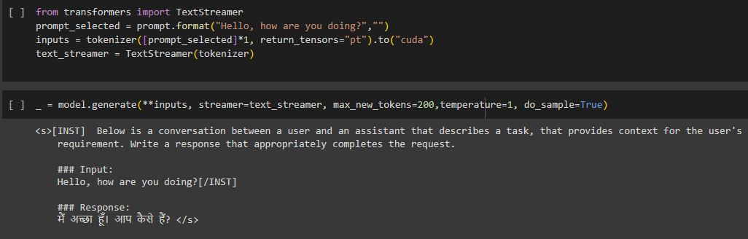
Code walk through
We can run inference against any of the listed models (new models will be updated regularly) seamlessly by just running the above 2 cells.
We create a TextStreamer object to stream the text output. You can see the prompt template that was used for fine-tuning.
From start to finish, everything is accomplished easily using the python package without which the code would be poorly structured. The package also provides other utility functions for processing datasets, helping you to process datasets easily, abstracting most of the code.

Slide 20
Learnings from the hackathon and community support
Developing efficient data consumption and processing pipelines.
Explored and understood the various methods of pre-training and fine-tuning and the correct practices associated with the same.
Utilized community support during phases when we experienced difficulties.
We have built a novel architecture incorporating a pre-training step using LoRA adapters followed by task-specific fine-tuning on 4 major tasks we identified as necessary for each language.
Testimonials highlighting key learnings and support
Participating in this hackathon was immensely beneficial, providing us with essential insights into dataset curation, pipeline setup for model refinement, and the creation of highly precise and effective models.
Furthermore, this project facilitated our learning of the Llama2-7B model and its application, as well as tokenization techniques tailored for Indic languages.

Slide 21
How this has helped you
This project has helped us understand the nuances behind training LLMs and the importance of obtaining correct outputs from an LLM.
Beyond enhancing our technical expertise, we are optimistic that this initiative will gain traction as an Open Source project and attract organizational support in the future.
Our contributions to the Open Source Community have been substantial, encompassing the creation of datasets, tokenizers, and both fine-tuned and pre-trained models that are readily available for community use.
The project facilitated a lot of interest in our University as well and serves as a potential project that would definitely shine on our Resume!
What is your future vision for this project
Our vision for the future involves expanding our project to encompass all Indian languages and enhancing the training of our models to be safer and more accurate.
We aim to add support for voice-based inputs that can cater to the linguistic diversity of India, ensuring broader accessibility and inclusivity.
We intend to document our work in a technical paper, as we believe this project holds significant promise in terms of innovation and its contribution to the domain of Extending LLMs to Indic languages.
This expansion will not only enrich the linguistic landscape but also empower more users to engage with technology in their native languages, fostering greater connectivity and understanding across communities.

